Slide 1
平台是什么？

Slide 2


对于开发者，是一个代码开发类库的集合
对于系统运维者，是一些公共应用的集合
对于架构人员，是一些公共服务的集合
这就是我们的平台

Slide 3
公共应用

Slide 4
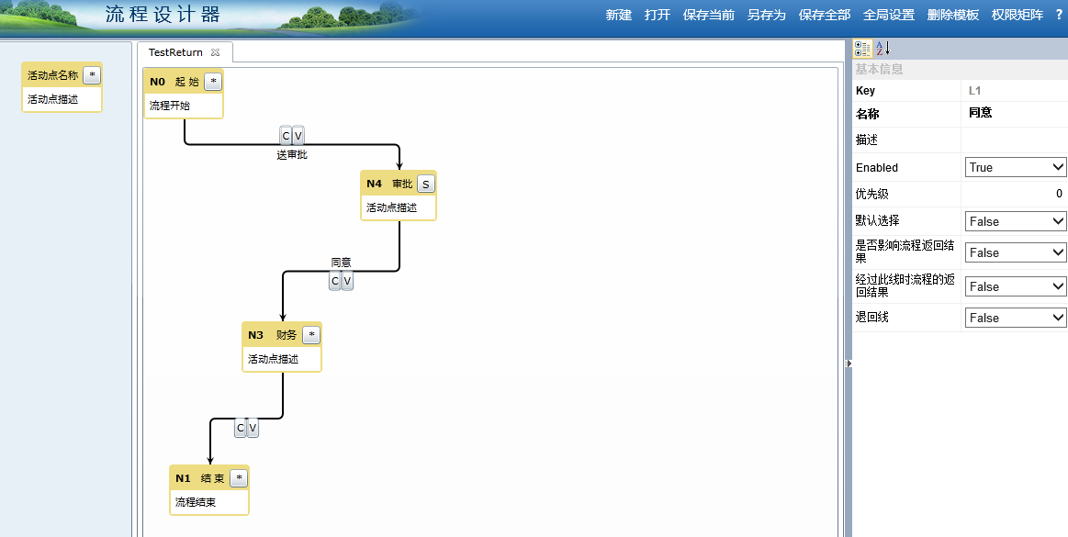
流程设计器

Slide 5
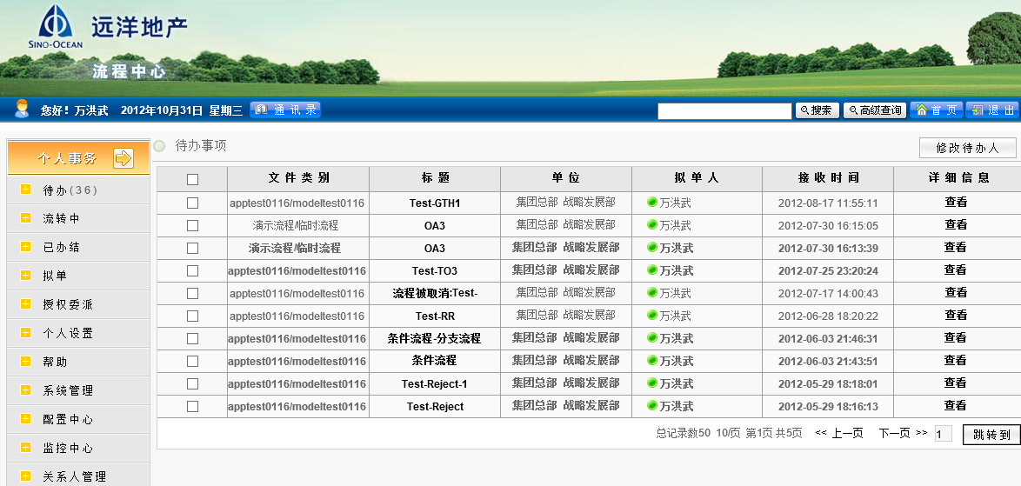
流程中心
待办
流转中
授权委派
个人设置
…

Slide 6
管理功能
仅由管理员使用
流程调整
任务、计划定义
权限中心
日志和监控

Slide 7
公共服务

Slide 8
所有公共服务
组织和人员
授权信息
流程引擎
文档服务
单点登录
Notes:
这里所提到的所有的公共服务，指的都是以Web Service提供的松耦合调用接口。调用者和被调用者不属于同一个进程。

Slide 9
组织和人员
Notes:
组织和人员+授权信息组成了权限中心

Slide 10
授权信息

Slide 11
流程引擎服务

Slide 12
单点登录

Slide 13
文档服务
Notes:
文档的存储服务。Word文档根据模版进行填充服务。
Excel文档生成和解析不是Web Service。属于平台类库。
SharePoint的Excel Service不算平台功能，因此不列在此，此功能用于HR薪酬核发的薪酬计算。

Slide 14
后台服务
邮件发送
人员同步
流程异常数据分析
计划任务执行
Notes:
后台服务会作为一个始终在后台执行。目前和某一台Web服务器部署在一起。

Slide 15
邮件发送
Notes:
文档的存储服务。Word文档根据模版进行填充服务。
Excel文档生成和解析不是Web Service。属于平台类库。
SharePoint的Excel Service不算平台功能，因此不列在此，此功能用于HR薪酬核发的薪酬计算。

Slide 16
人员同步
Notes:
文档的存储服务。Word文档根据模版进行填充服务。
Excel文档生成和解析不是Web Service。属于平台类库。
SharePoint的Excel Service不算平台功能，因此不列在此，此功能用于HR薪酬核发的薪酬计算。

Slide 17
流程异常数据分析
Notes:
文档的存储服务。Word文档根据模版进行填充服务。
Excel文档生成和解析不是Web Service。属于平台类库。
SharePoint的Excel Service不算平台功能，因此不列在此，此功能用于HR薪酬核发的薪酬计算。

Slide 18
计划任务执行
Notes:
文档的存储服务。Word文档根据模版进行填充服务。
Excel文档生成和解析不是Web Service。属于平台类库。
SharePoint的Excel Service不算平台功能，因此不列在此，此功能用于HR薪酬核发的薪酬计算。

Slide 19
平台类库

Slide 20
平台类库所包含的内容
Configuration
Caching
RGB 0 113 188
RGB 0 174 239
RGB 0 166 0
RGB 140 198 0
RGB 255 242 0
RGB 255 190 0
RGB 255 138 0
RGB 255 83 0
RGB 255 0 0
RGB 255 0 151
RGB 145 0 145

Slide 21
核心部分

Slide 22
数据访问

Slide 23
人员、认证和授权

Slide 24
流程引擎

Slide 25
前端技术

Slide 26
公共控件

Slide 27
表单和流程

Slide 28
Microsoft Colors
Choose 1 core color (related to your organization) and up to 3 more secondary colors. The core color should be used on the first walk-in slide.
RGB 0 0 166
RGB 0 113 188
RGB 0 174 239
RGB 0 166 0
RGB 140 198 0
RGB 255 242 0
RGB 255 190 0
RGB 255 138 0
RGB 255 83 0
RGB 255 0 0
RGB 255 0 151
RGB 145 0 145

Slide 29
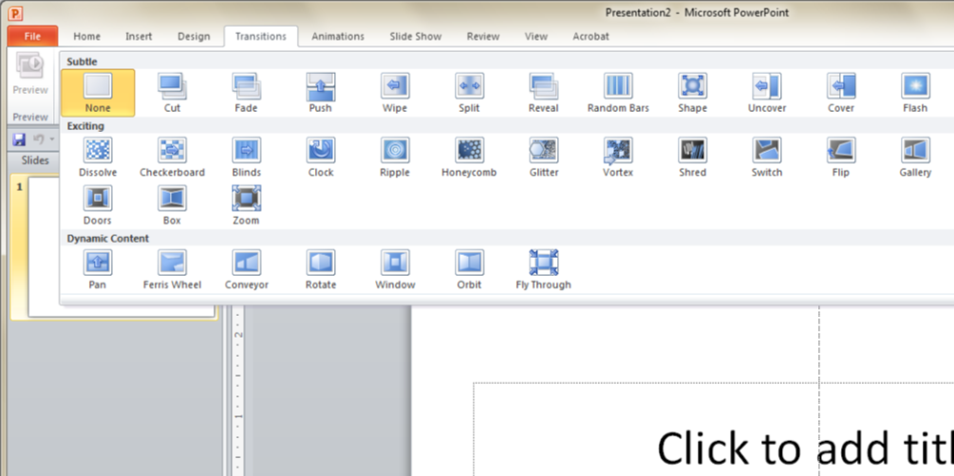
Choosing Correct Slide Transitions
Limit the slide transitions to two types per deck.
Choose from these preferred settings.
Fade with 1 second duration
Reveal with 1.5 second duration
Push with 1.5 second duration, from right
Pan with 1.5 second duration, from right

Slide 30

General Layout Design
Grids
Grid systems help to create meaningful, consistent organization of information and elements to tell rich stories.
More than grids, structured information.
Reductive design
Fewer, carefully used elements help to reflect the innovative, modern look of our brand. Using our colors, type, logos, grid, the right image(s), and simple clean approach you can build almost anything. Product derived images, icons, screen shots, help to communicate the way in which Microsoft software can help improve peoples lives.

Slide 31
All About Typography

Slide 32
Presentation Fonts/Typography
What are the font choices and sizes?
Any font size 28pt or larger should use Segoe UI Light
Any type that is less than 28pt should use Segoe UI
On one slide, try to use a maximum of 3 font sizes
Where to start
Control focus by using scale versus bullets
Use color to draw focus when necessary
Start with main topic at 40pt and subtopics at 20pt
Title/sentence casing and periods
Title text should be “title caps” including a, is, of, & and
All supporting slide text should be sentence case
Periods should only be used on the title & main topics for complete sentences

Slide 33
Preferred Text Layout
Size 40pt for the main topics
Size 20pt for the subtopics
Size 20pt for the subtopics
Size 40pt for the main topics
Size 20pt for the subtopics
Size 20pt for the subtopics
Size 40pt for the main topics
Size 20pt for the subtopics
Size 20pt for the subtopics

Slide 34
If Bullets Are Required
Size 40pt for the main topics
Size 20pt for the subtopics
Size 18pt for sub/subtopic
Size 20pt for the subtopics
Size 18pt for sub/subtopic
Size 40pt for the main topics
Size 20pt for the subtopics
Size 18pt for sub/subtopic
Size 20pt for the subtopics
Size 18pt for sub/subtopic

Slide 35
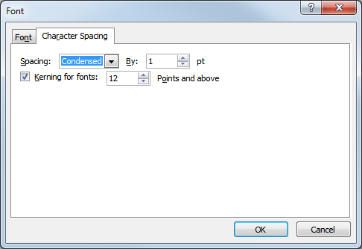
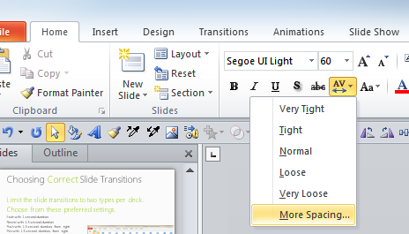
Character Spacing
Type that is 41pt – 60pt should be condensed by 1pt
Type that is 18pt – 27pt should condensed by .7pt

Slide 36
All About Tiles

Slide 37

Tile Spacing & Sizing Is Important
.03x
1x
.485x

Slide 38

When A Wider Tile Is Needed
2x
3x
1x

Slide 39
A Single Row Of Tiles
1x
~.06x

Slide 40


A Copy & Paste Sizing Guide
These two .pngs are guides.
Copy and paste this .png image into a new slide
Resize the image for your desired size
Create new shapes on top, then delete the .png below
To constrain a new square shape, hold the shift key

Slide 41
All About Charts

Slide 42
Keep Charts Clean & Modern
1.0
80 went to the market
Statistical Trend
89 stayed home
.03x
.03x
1.0
Statistical Survey
68 had roast beef
77 had none
1x
1x

Slide 43
Lots Of Data? Minimalize & Plan
1.5x
.485x
Brand 1
Brand 2
13%
140M
130M
125M
58%
1x
Brand 3
19%
IBM
VMWare
Oracle
Cisco
Apple
Other
.03x
.03x

Slide 44
Carry Metro Across Your Needs
Not all content needs to be in tiles.
Type is what articulates the message
Text doesn’t need to be bulleted.
Text size can reinforce and impact
Metro isn’t just about tiles.
Fierce reduction of elements
Well defined hierarchy
Scale and contrast to create interest, and focus
Keen attention to detail
9%
58%

Slide 45
All About Photos

Slide 46

Full Bleed Photos
Pictures can set a mood or evoke emotion, making for a more memorable presentation.

Slide 47

Full Bleed Photos
Pictures can set a mood or evoke emotion, making for a more memorable presentation.
Sometimes a gradient shape below the text can help legibility.

Slide 48


Putting Text On A Picture Tile
1.5x
1x
Try to keep it on 1 line.
If you need more text real estate, go wide.
.2x

Slide 49


Alternative: Text On A Picture Tile
1.5x
1x
Try to keep it on 1 line
If you need more text real estate, go wide.
.2x
Shape with a gradient
Position 100% with 16% transparency Position 0% with 100% transparency

Slide 50

Device Imagery
Hardware guidelines
Use the latest devices from current year’s release.
Screen captures should be up-to-date.
Remove OEM logos when possible
Drop shadows for devices only
Use drop shadows to provide subtle depth
Shadows shouldn’t exceed 30% opacity
Shadows shouldn't be less than 70 transparent

Slide 51
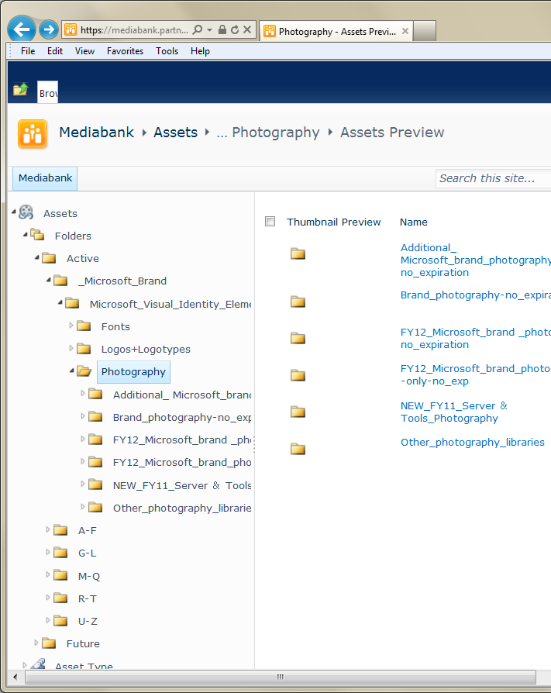
Where Can You Find Our Photos?
A few great places to start
Mediabank: The main source for photography
https://mediabank
PressPass: A great place for the latest and greatest
http://www.microsoft.com/presspass/default.mspx
Brandtools: A resource for information on the Microsoft brand
https://brandtools

Slide 52
All About Icons

Slide 53



Choosing The Right Icons
Guidelines for icons
Choose from existing brand icons
Use text within the tile for descriptions when necessary.
If you need new icons…
Remember to choose simple and minimal
Less unnecessary detail is better
Use metro/transit signage as a good example of style
Icons should only appear in white or black

Slide 54
Sample Layouts

Slide 55
Sample Layout 1
Size 40pt for the main topics
Size 20pt for the subtopics
Size 20pt for the subtopics
Size 40pt for the main topics
Size 20pt for the subtopics
Size 20pt for the subtopics
Text/Icon/Pic
Text/Icon/Pic
Text/Icon/Pic
Text/Icon/Pic

Slide 56



Sample Layout 2
Text goes here
Supporting text here
Size 20pt for the subtopics
Text goes here
Supporting text goes here
Supporting text goes here
Text goes here
Supporting text goes here
Supporting text goes here
Text/Icon/Pic
Text/Pic
Text/Pic
Text/Icon/Pic
Text/Icon/Pic
Text/Pic

Slide 57

Sample Layout 3
Text goes here
Supporting text here
Size 20pt for the subtopics
Text goes here
Supporting text goes here
Supporting text goes here
Text goes here
Supporting text goes here
Supporting text goes here
Text/Icon/Pic
Text/Icon/Pic
Text/Icon/Pic
Text/Icon/Pic
Text/Pic

Slide 58

Sample Layout 4
Text goes here
Supporting text here
Size 20pt for the subtopics
Text goes here
Supporting text goes here
Supporting text goes here
Text goes here
Supporting text goes here
Supporting text goes here
Text/Icon/Pic
Text/Icon/Pic
Text/Pic

Slide 59

Sample Layout 5
Text goes here
Supporting text here
Size 20pt for the subtopics
Text goes here
Supporting text goes here
Supporting text goes here
Text goes here
Supporting text goes here
Supporting text goes here
Text/Icon/Pic
Text/Icon/Pic
Text/Icon/Pic
Text/Icon/Pic
Text/Pic

Slide 60

Sample Layout 6
Text/Icon/Pic
Text/Icon/Pic
Text/Icon/Pic
Text/Pic

Slide 61

Sample Layout 7
Text/Icon/Pic
Text/Icon/Pic
Text/Icon/Pic
Text/Icon/Pic
Text/Icon/Pic
Text/Pic

Slide 62

Sample Layout 8
Text/Icon/Pic
Text/Icon/Pic
Text/Icon/Pic
Text/Icon/Pic
Text/Pic

Slide 63

Simple, clean, & impactful text here.

Slide 64

Simple, clean, & impactful text here.

Slide 65
Presentation Title
Speaker Name, Title

Slide 66
Notes (hidden)
Some speakers at Microsoft like to use this slide for hidden “notes slides”.
Delete it if you don’t want to use it.
NEXT: <next slide title>

Slide 67

© 2012 Microsoft Corporation. All rights reserved. Microsoft, Windows, Windows Vista and other product names are or may be registered trademarks and/or trademarks in the U.S. and/or other countries.
The information herein is for informational purposes only and represents the current view of Microsoft Corporation as of the date of this presentation. Because Microsoft must respond to changing market conditions, it should not be interpreted to be a commitment on the part of Microsoft, and Microsoft cannot guarantee the accuracy of any information provided after the date of this presentation. MICROSOFT MAKES NO WARRANTIES, EXPRESS, IMPLIED OR STATUTORY, AS TO THE INFORMATION IN THIS PRESENTATION.

